Slide 1



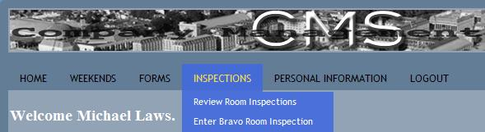

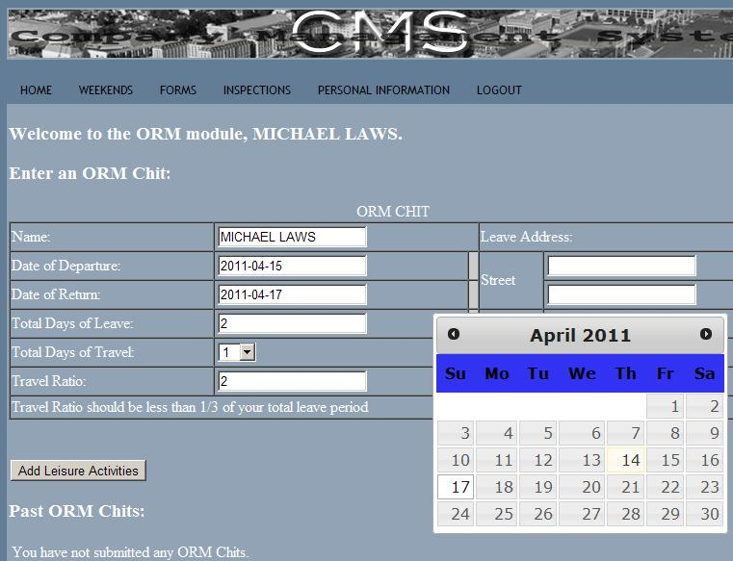


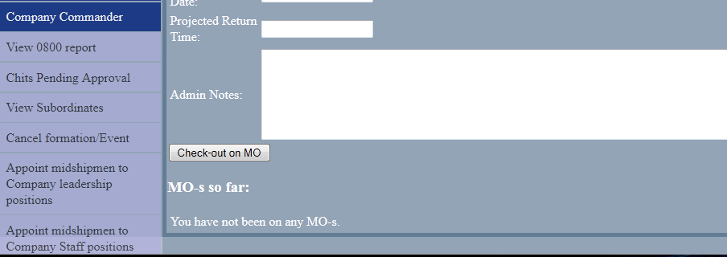

Company Management System
CMS is a web interfaced, database back ended, modularly designed, system to manage the daily paperwork that a Company of Midshipmen deals with on a daily basis.
Topical Areas: Web, Database, Middleware, OOP, Frameworks
Top Three Challenges
Complexity Management
Many MIDN data points to keep track of and reference
SOLUTION: Use the Django framework to aid in design and development
2. Team coordination and cohesion
Dynamic projects require active communication
SOLUTION: External server based solutions for code storage and execution
3. Learning a new framework and language
We had to learn the language python and the framework Django
SOLUTION: Time and effort.
Figure01: Dynamic Navigation Bar
MIDN Laws
midn Harrison
Mistakes Made:
Did not fully solidify requirements before coding
Did not fully learn the potential or quirks of Django before coding
Suggestions for the Future:
Spend time fully learning the languages and frameworks and their internal systems before using them
Figure02: Dynamic ORM Chit with Popup Calendar
MIDN Rabe
CONCLUSIONS:
Simple problems may have complicated solutions.
Good team communication is as important as good code.
A framework to aid development may or may not be a good idea depending on the application.
MIDN Hatley
Figure01: Dynamic Navigation Bar

